Slide 1

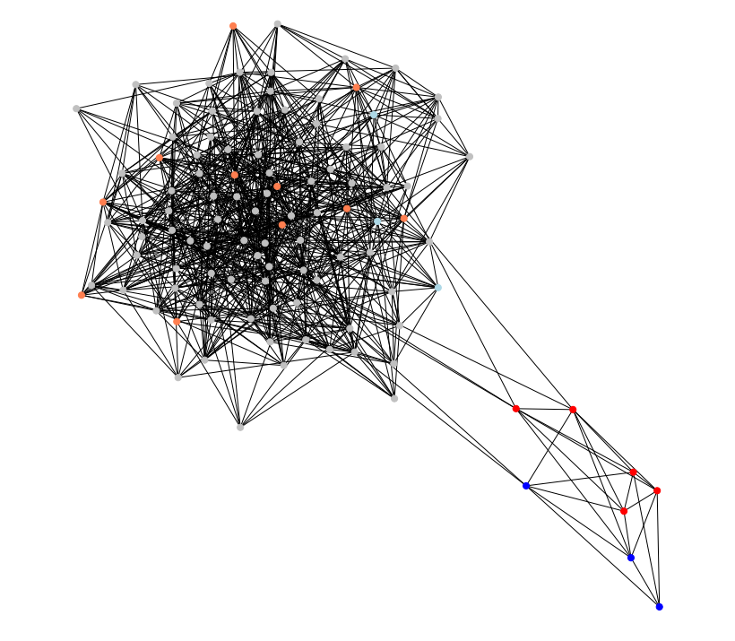
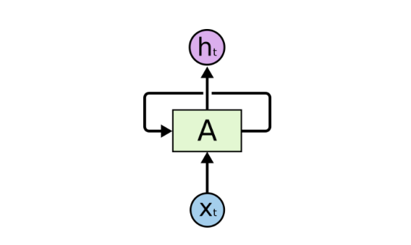
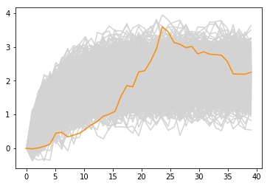
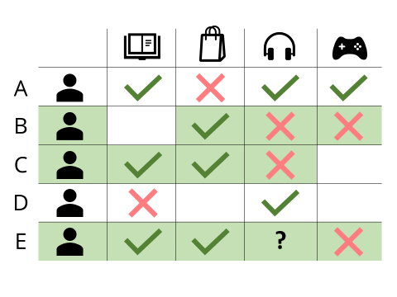
USF ISDS PhD Oral Exam – 2019
Abdallah Musmar

Slide 2
Dissertation Plan
Project | Co-Authors | Status | Details | Next Steps
Signal to Noise Ratio in Social Media: A Case of Cryptocurrency Prices | He Zhang, Wolfgang Jank, Balaji Padmanabhan | 50% | Gathered tweets on four cryptocurrencies between May 2018 and September 2019 Calibrated a stochastic differential equation that explained the economic bubble of bitcoin price between 2016-2018 Applied sentiment analysis to the tweets and in the process of clustering | Creating a database for the combined datasets Advanced text mining to extract more features Continue model building
Governance of Digital Platforms in the Modern Age of AI | He Zhang, Sunil Mithas, Balaji Padmanabhan | 70% | Created a simulation environment to study the governance of AI by platforms in the presence of misinformation The goal is to find a set of policies that can reduce the platform problems identified from the simulation regarding how fake news affects users. | Add more depth to the governance platform Run simulation with suggested policies and compare results
Using Deep Learning in Recommender Systems | TBD | 10% | Learned about various traditional recommender systems Learned about various deep learning architectures that are used in recommender systems | Extensive literature Review Gather data Clean data Model Building

Slide 3
Governance of Digital Platforms in the Modern Age of AI
Abdallah Musmar
He Zhang
Sunil Mithas
Balaji Padamanbhan

Slide 4
Introduction and Research Questions

Slide 5
Background Summary
The reliability of information has been an increasing concern with the new technology capabilities that can create fake information that is hard to distinguish from real information given the new era of AI.
We study the effect of incorporating fake news in a social network on the perception of real news in social media.
Our study uses agent-based modeling to create an environment that resembles a social media site where users consume and react to news articles from different sources.
Then we propose a governance framework that will remediate misinformation issues that arise from the spread of fake news

Slide 6
Research Questions
RQ1: What is the effect of injecting “fake news” in a user’s news feed on the users’ decisions when processing “real news”?
H1: Increasing the percentage of “fake news” shared on a social media platform to a certain configuration increases the percentage of users incorrectly classifying real news as fake news
H2: Increasing the percentage of “fake news” shared on a social media platform to a certain configuration increases the percentage of users incorrectly classifying fake news as real news
H3: Increasing the percentage of “fake news” shared on a social media platform to a certain configuration leads to creating more polarized communities and sub-communities

Slide 7
Research Questions
RQ2: What possible configurations can be implemented on a digital platform in order to reduce the user’s perception of real news as fake news?

Slide 8
Research Method

Slide 9
Simulation Design – over the next few slides
Object-Oriented design of the simulation and the agents
Creating the social network from the objects
Flow chart of a run of the simulation
Pseudo code of the decisions made by the agents
Preliminary results of the first few runs

Slide 10
News_article
Attributes:
news_article_id(int)
source_id(int)
sentiment (float between (-5,-1) and (1,5))
num_shares (int >= 0)
is_fake (boolean fake:1 , real:0)
User
Attributes:
user_id(int)
individual_bias (float between -1 and 1)
is_analytical (boolean)
source_credibility {}
news_articles []
classifier – RandomForest or DeepLearning ANN
Methods:
generate_source_credibility(news_sources)
classify_news_article(news_article)
train_classifier
assess_bias()
add_article (news_article)
News_source
Attributes:
news_source_id(int)
reliable (boolean)
news_articles []
Methods:
add_article (news_article)

Slide 11
How to create a social network that has news sources and users? Also the network has communities and biases?

Slide 12
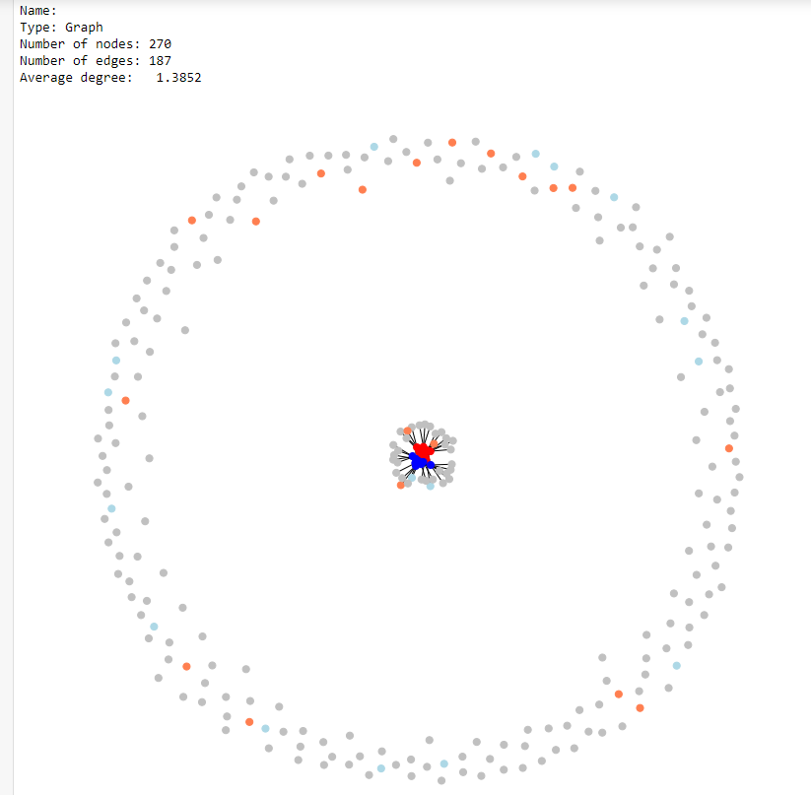
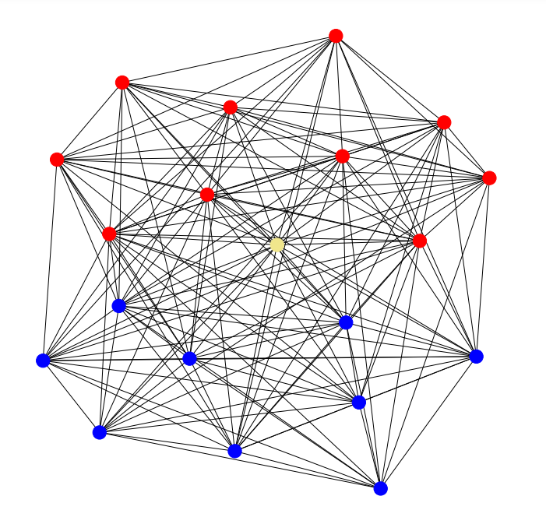
Add news sources
Add users

Slide 13
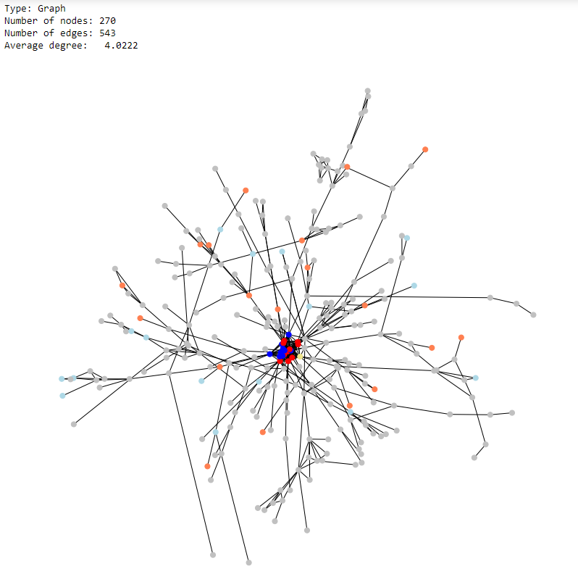
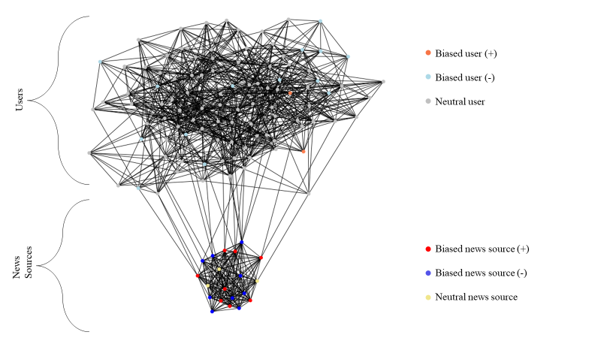
Connect users
Create communities

Slide 14
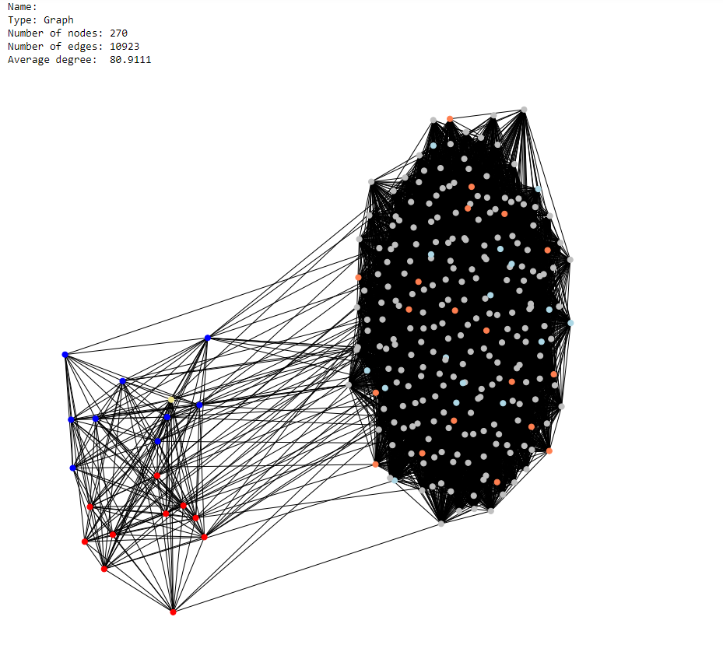

Slide 15
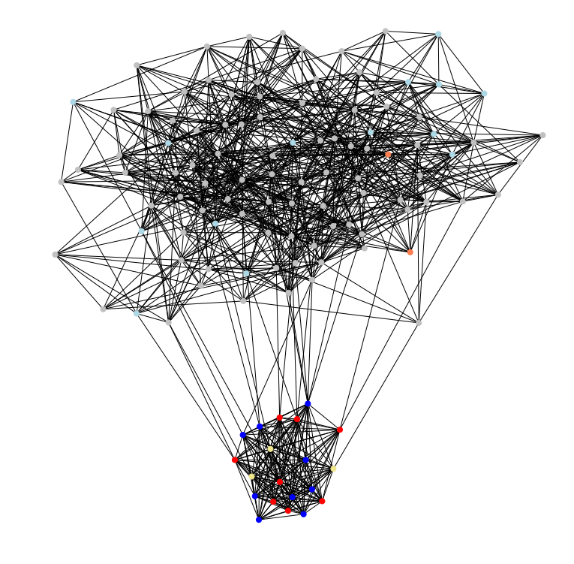
Biased user (+)
Biased user (-)
Neutral user
Users
News Sources
Biased news source (+)
Biased news source (-)
Neutral news source

Slide 16
-Create the network
-Add users
-Add news sources
NETWORK
user
user
user
user
user
user
source
source
user
user

Slide 17
-Users add connections
-Users follow sources
NETWORK
user
user
user
user
user
source
user
user
source
user
Notes:
Decisions:
1- When a user joins a network, the user chooses the users and news sources they want to follow
2- The network decides if the users or news sources are legitimate, i.e. do not break the network’s policies

Slide 18
How are news events being shared in the network?

Slide 19
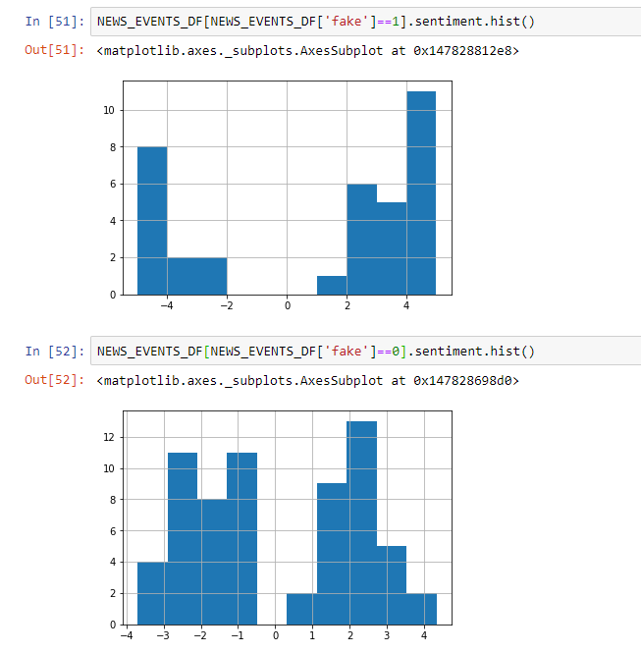
FAKE
Sentiment (of the headline)
REAL
Sentiment (of the headline)

Slide 20
-In a single step “iteration”
-Sources share events
-Users assist the flow of information by sharing
NETWORK
user
e1
user
e1
e2
user
user
e1
e1
e2
e2
user
e1
e1
source
user
e1
e1
e2
e2
user
source
e2
e2
e2
user
Notes:
Decisions:
1- When an event happens, the news source decides whether they want to publish it or not
2- The news source also decides if they want to publish a fake article or not (fake encapsulates anything that has not happened)
3- The users classify whether the news article is fake or not
4- The users decide if they want to share the information or not
5- The users decide if they want to keep any of their connections or not
6- The users decide if they want to follow new connections or not

Slide 21
Start
Create empty graph and add news sources. Connect news sources based on their similarity
Create E news events (e=1, E)
Add users to the graph. Connect the users to each other and to news sources in an iterative process that aims at creating communities
New event shared by its original news source. The source’s neighbors find the news article in their feed
News sources share the news event based on their reliability and based on similarity. The list of neighbors may expand upon sharing
Users classify the news event they have not seen. They also might share based on a share probability. The list of neighbors may expand upon sharing
e <=E
Yes
No
End

Slide 22
Pseudo code for news diffusion
For a news event e in a set of news events E:
get_article_attributes(e): (sentiment, number of shares, and source attributes)
source.articles.add(e) #add the event to its source’s articles (share)
neighbors = get_neighbors(source) and store it in a list
while neighbors is not empty:
neighbor = neighbors.pop()
flag neighbor so it will not be visited again for e
if neighbor is a user:
classify e and compute P(sharing)
if share decision is True:
neighbor.articles.add(e) (share)
update number of shares and update neighbors adding unvisited neighbors of neighbor
else if neighbor is a news source:
compute P(sharing)
if share decision is True:
neighbor.articles.add (share)
update number of shares and update neighbors adding unvisited neighbors of neighbor

Slide 23
-Understand the flow of information between users
and the emergence of
more bias in users
NETWORK
NETWORK
source
source
user
user
user
user
user
user
user
source
user
source
user
user
user
user
user
user
user
user
user
user
user
user
user
user
user
user
user
user
user
user
user
user
user
user
user
source
source
source
source
user
user
user
user
user
user
user
user
user

Slide 24
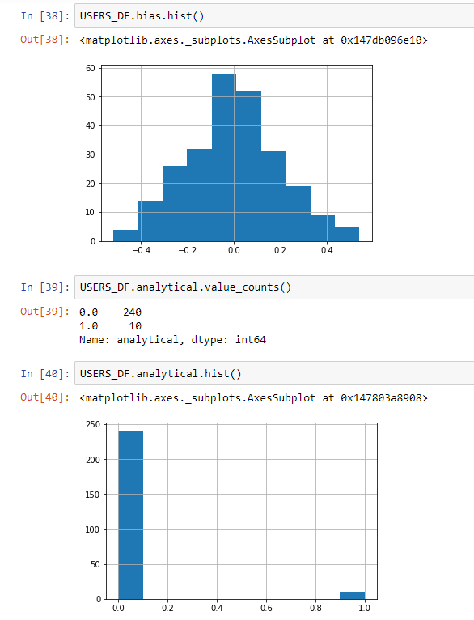
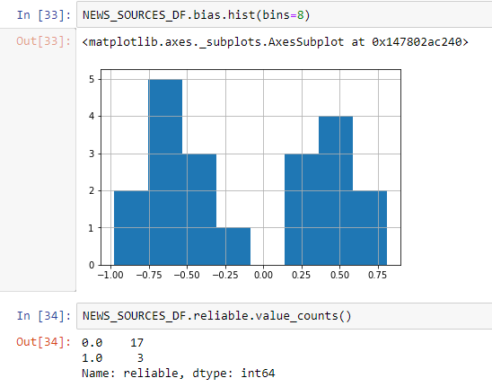
Preliminary Results after running the simulation
Model Hyperparameters:
Number of sources: 20
Initial news source bias μ = ±0.5
Number of users: 250
Initial user bias μ = ±0.01
Number of events: 100
Fake News percentage: minimum 5% - maximum 95% in 15% increments
Average degree of graph = 80

Slide 25
Preliminary Results after running the simulation

Slide 26
Start
Create empty graph G which will contain the connection information between users and news sources
User initially connects to any other user under a very small probability = P(0.005)
Users check if any of their neighbors shared a new event
Define news article class (source, source bias, sentiment, number of shares, fake)
User connects to an indirectly connected user through their mutual connections based on a random probability in an iterative process until average degree of graph G is achieved
N
new events > 0
Define news source class (Bias(μ=0.5,σ=2) Reliability (P(reliable)=0.1). Then create a list of news articles for each source
Classify new articles
Count misclassifications
N
events > 0
Y
Y
Fake = 1
N
Add news sources to graph G
Connect any two news sources based on a probability of similarity = P((2-Δbias)/2)
New event is shared by a news source
P(Share) = 0.01
P(Share) = 0.1
News sources check if any of their neighbors shared a new event
Define user class (Bias(μ=0,σ=2)
Analytical & Motivated (P(A&M)=0.05)
Classifier = Default trained classifier
N
P(Share) = 1
Neighbor is reliable
Y
Add users to graph G
User follows a news sources based on two probabilities: (1) Probability of similarity = P((2-Δbias)/2) AND
(2) Probability of random connection = P(0.01)
Y
N
User shares the article on their feed
Calculate P(Neighbor is similar)
P(Sim)=1
News source shares the article on their feed
Y
End simulation
N

Slide 27
RQ2
Guideline | Research
Design as an Artifact | The artifact designed in this paper is the social network environment which will be tested under several governance frameworks
Problem Relevance | The artifact is designed and instantiated to address a current problem on social media with the spread of fake news and its effects on the users. There is also potential for this problem to grow in the near future with more advances in AI.
Design Evaluation | The evaluation of the model is determined by comparison of the data that is generated with real data that was obtained from social media
Research Contributions | The first contribution is the simulation environment which can generate new data on user activity given model settings of the social media network dynamics. The second contribution is the governance framework that ensures that the mass effect of fake news is contained or remediated with some configurations from the network.
Research Rigor | Building on complex systems, fake news classification, and AI governance literature. This research proposes a framework to illustrate the effects of disinformation on a social network and the potential remediations to reduce the negative effects associated with disinformation.

Slide 28
Q&A

Slide 29
Thank you!

